Slide 1
Systems Analysis and Design
Course Code: CSE 305
Instructor:
Dr. Shah Murtaza Rashid Al Masud
Assoc. Prof. CSE Dept., UAP

Slide 2
Learning Resources
Textbook | Modern System Analysis & Design- Jeffrey Hpffer, Joey George, Joseph Valacich, 6th edition, Pearson, (Available in Prince Mishal Library)
Other References | “Systems Analysis and Design”, (latest edition), Kendall & Kendall, Prentice-Hall

Slide 3
Evaluation Scheme
Components | Weight
Class test/Quizzes | 30%
Midterm | 20%
Final Examination | 50%
Total | 100%

Slide 4
Course Summary
Introduction and SDLC
System Development in an Organizational Context
Managing the Information System Projects
Determining System Requirements
Analyzing System Process Requirements
Object Oriented Analysis and Design: Use cases
Object Oriented Analysis and Design: Activity Diagrams
Object Oriented Analysis and Design: Sequence Diagrams
Object Modeling: Class Diagrams
Designing Database, Forms & Reports Design
Systems Repository, Implementing and Maintaining the System

Slide 5
Introduction
Systems Analysis and Design (SAD) is a process of planning and developing high quality and new business Information Systems (IS) which
combines Information Technology (IT),
People and
Data to support business requirements.

Slide 6
Introduction
Information Systems Analysis and Design: Complex organizational/business process where computer-based information systems are developed and maintained.
Application Software: Computer software designed to support organizational functions or processes.
Systems Analyst: the people/person who Performs Organizational role the most responsible for analysis and design of information systems

Slide 7
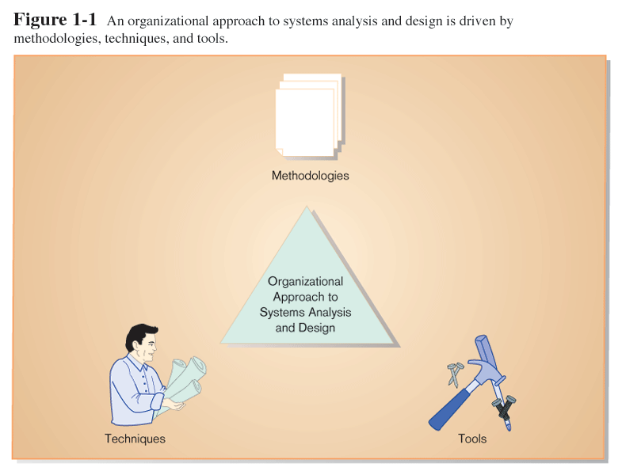
Introduction (cont.)

Slide 8
Information—A Key Resource
Fuels business and can be the critical/key factor in determining the success or failure of a business
Information needs to be managed correctly, carefully
Managing computer-generated information differs from handling manually produced data

Slide 9
Roles of the Systems Analyst
The analyst must be able to work with people of all descriptions and be experienced in working with computers.
Three primary roles:
Consultant
Supporting expert
Agent of change

Slide 10
Qualities of the Systems Analyst
Problem solver
Communicator
Strong personal and professional ethics
Self-disciplined and self-motivated

Slide 11
Systems Development Life Cycle (SDLC) (Prof. Kendall)
The systems development life cycle : is a systematic approach to solving business problems .
Reasons for enhancement the system :
Adding additional features.
Requirements change over time
Technology H\W and S\W change rapidly.

Slide 12
Systems Development Life Cycle (SDLC) (Prof. Hoffer)
SDLC is the methodology for developing, maintaining, and replacing information systems
Phases in SDLC:
Planning
Analysis
Design
Implementation
Maintenance

Slide 13
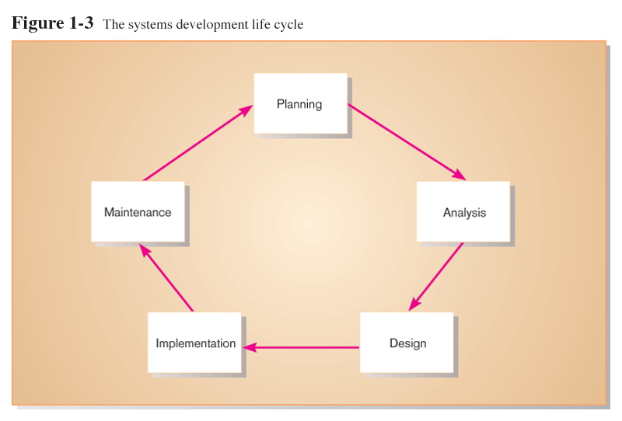
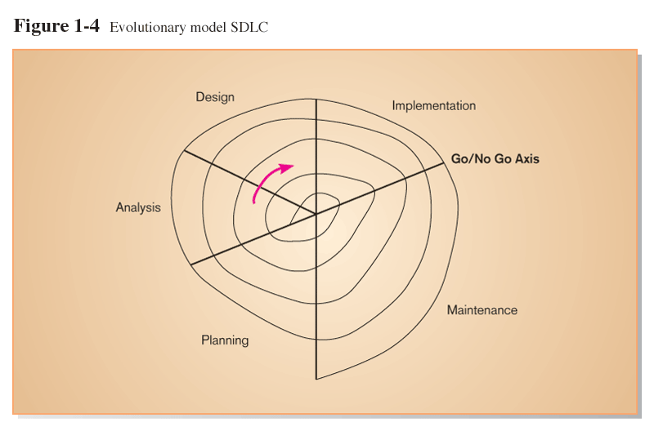
Standard and Evolutionary Views of SDLC

Slide 14
SDLC Planning Phase
Identify, analyze, and arrange IS needs

Slide 15
SDLC Analysis Phase
Study system requirements

Slide 16
SDLC Design Phase
Logical design: functional specification(data, process, input, output)
Convert recommended solution to system specifications
Physical design: technical specifications (system S/W, programs, files, network)

Slide 17
SDLC Implementation Phase
Code, test, install, and support the information system

Slide 18
SDLC Maintenance Phase
Systematically repair and improve the information system

Slide 19
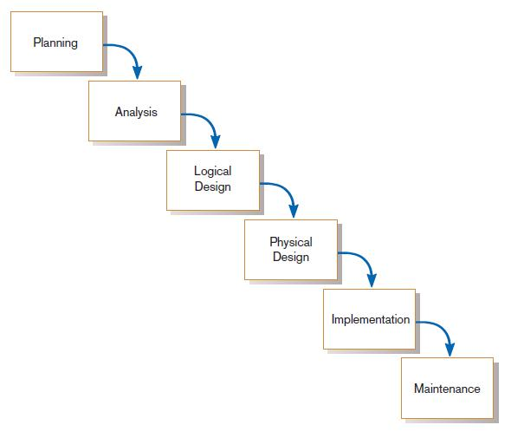
Traditional Waterfall SDLC
One phase begins when another completes, with little backtracking and looping.
FIGURE 1-4
A traditional waterfall SDLC

Slide 20
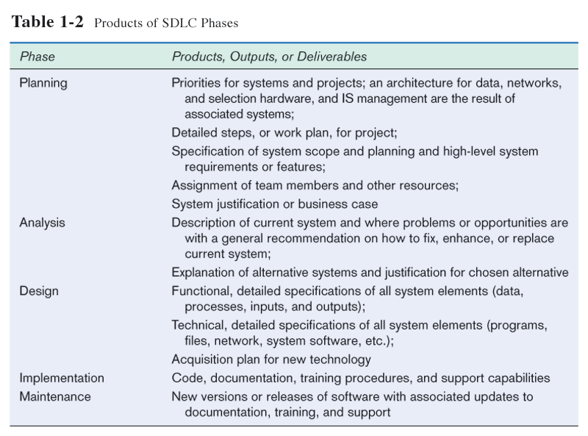

Slide 21
Systems Development Life Cycle (SDLC) (Prof. Kendall)
Traditional methodology for developing, maintaining, and replacing information systems
Phases in SDLC:
Identifying problems
Determining requirements
Analysis systems need
Design the systems
Development and documentation
Testing and maintenance
Implementation

Slide 22
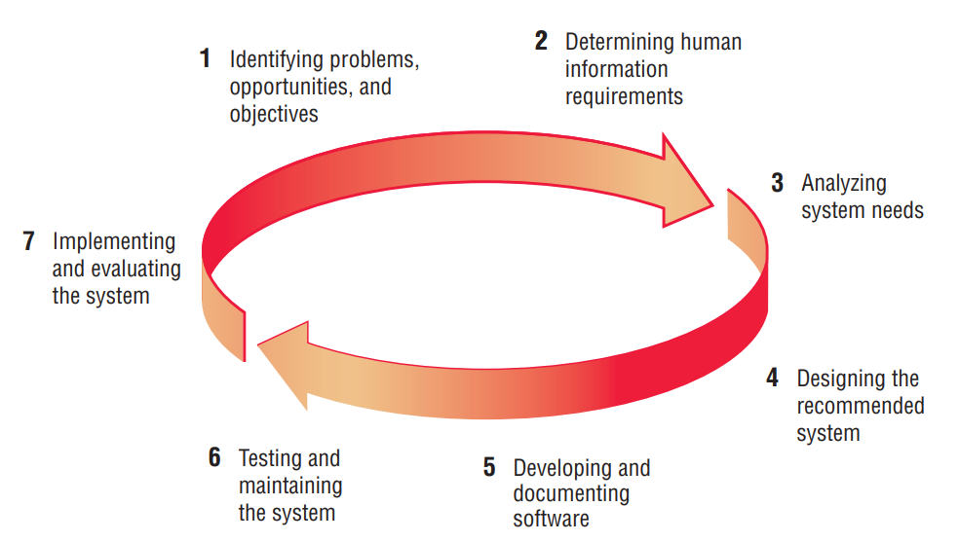
Systems Development Life Cycle (SDLC) (Prof. Kendall)

Slide 23
Systems Development Life Cycle (SDLC) (Prof. Kendall)
1. Identifying Problems, Opportunities, and Objectives
In this first phase of the systems development life cycle, the analyst is concerned with correctly identifying problems, opportunities, and objectives. This stage is critical to the success of the rest of the project, because no one wants to waste subsequent time addressing the wrong problem.

Slide 24
Systems Development Life Cycle (SDLC) (Prof. Kendall)
The people involved in the first phase are the users, analysts, and systems managers coordinating the project.

Slide 25
Systems Development Life Cycle (SDLC) (Prof. Kendall)
2. Determining Requirements
In the information requirements phase of the SDLC, the systems analyst determines what information users need to perform their jobs.
At this point the analyst is examining how to make the system useful to the people involved.

Slide 26
Systems Development Life Cycle (SDLC) (Prof. Kendall)
Determining Requirements
The people involved in this phase are the analysts and users, typically operations managers and operations workers.
The systems analyst needs to know the details of current system functions:
who (the people who are involved),
what (the business activity),
where (the environment in which the work takes place),
when (the timing), and
how (how the current procedures are performed)
why the business uses the current system.
There may be good reasons for doing business using the current methods, and these should be considered when designing any new system.

Slide 27
Systems Development Life Cycle (SDLC) (Prof. Kendall)
3. Systems Analysis
At this point in the SDLC, the systems analyst prepares a systems proposal that summarizes what has been found out about the users, usability, and usefulness of current systems; provides cost-benefit analyses of alternatives; and makes recommendations on what (if anything) should be done. If one of the recommendations is acceptable to management, the analyst proceeds along that course. Each systems problem is unique, and there is never just one correct solution.

Slide 28
Systems Development Life Cycle (SDLC) (Prof. Kendall)
4. Designing the Systems
In the design phase of the SDLC, the systems analyst uses the information collected earlier to accomplish the design of the information system.
The analyst designs procedures for users to help them accurately enter data so that data going into the information system are correct.
In addition, the analyst provides for users to complete effective input to the information system by using techniques of good form and Web page or screen design.

Slide 29
Systems Development Life Cycle (SDLC) (Prof. Kendall)
5. Developing and Documenting Software
In the fifth phase of the SDLC, the analyst works with programmers to develop any original software that is needed. During this phase the analyst works with users to develop effective documentation for software, including procedure manuals, online help, and Web sites featuring Frequently Asked Questions (FAQs), on Read Me files shipped with new software.

Slide 30
Systems Development Life Cycle (SDLC) (Prof. Kendall)
6. Testing and Maintaining the System
Before the information system can be used, it must be tested. It is much less costly to catch problems before the system is signed over to users.
Maintenance of the system and its documentation begins in this phase and is carried out routinely throughout the life of the information system.

Slide 31
Systems Development Life Cycle (SDLC) (Prof. Kendall)
7. Implementing and Evaluating the System
In this last phase of systems development, the analyst helps implement the information system.
This phase involves training users to handle the system.
In addition, the analyst needs to plan for a smooth conversion from the old system to the new one. This process includes converting files from old formats to new ones, or building a database, installing equipment, and bringing the new system into production

Slide 32
Alternatives to Traditional SDLC
Agile Methodologies
Object oriented method

Slide 33
The Agile Approach/Method
In software/systems development, agile approaches involve discovering requirements and developing solutions through
the collaborative effort of self organizing
and
cross-functional teams and their customer(s)/end user(s).
Agile is a project management method that focuses on being flexible, working together, and improving.
Agile software development is all about moving fast and efficiently.

Slide 34
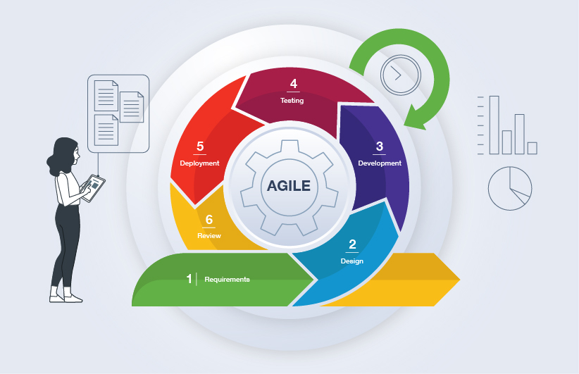
The Agile Approach/Method

Slide 35
The Agile Approach/Method
Agile Methodology meaning a practice that promotes continuous iteration/repetition of development and testing throughout the software development lifecycle of the project. In the Agile model in software testing, both development and testing activities are concurrent, unlike the Waterfall model.
In Waterfall model, development of the software flows sequentially from start point to end point.

Slide 36
The Agile Approach/Method
Agile method supports
adaptive planning (having an ability to change to suit changing conditions),
evolutionary development (the gradual development of information systems projects),
early delivery,
and
continual improvement

Slide 37
The Agile Approach/Method
Agile approach encourages flexible responses to change based on
values,
principal
core practices
methodology

Slide 38
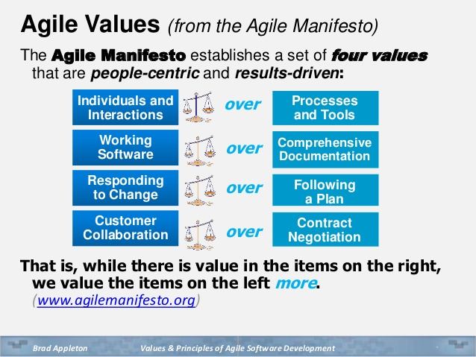

Slide 39
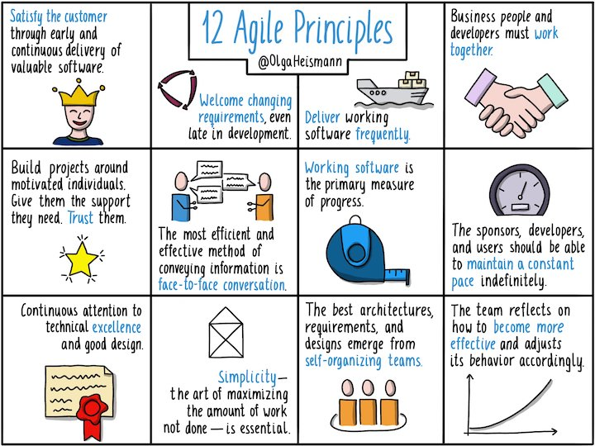

Slide 40
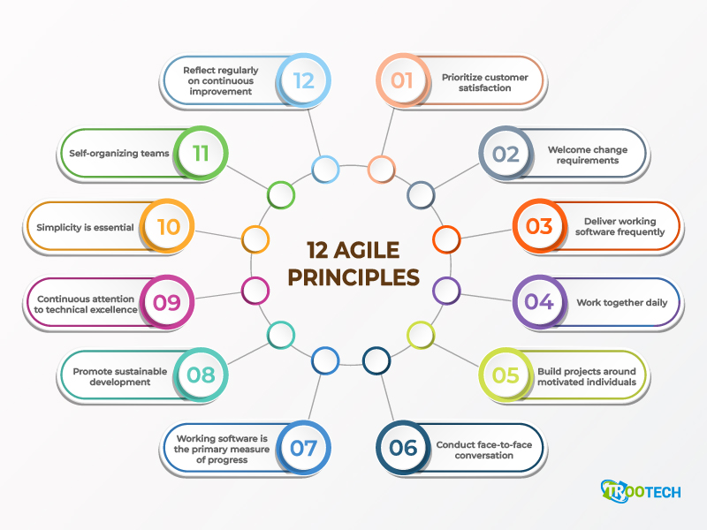

Slide 41
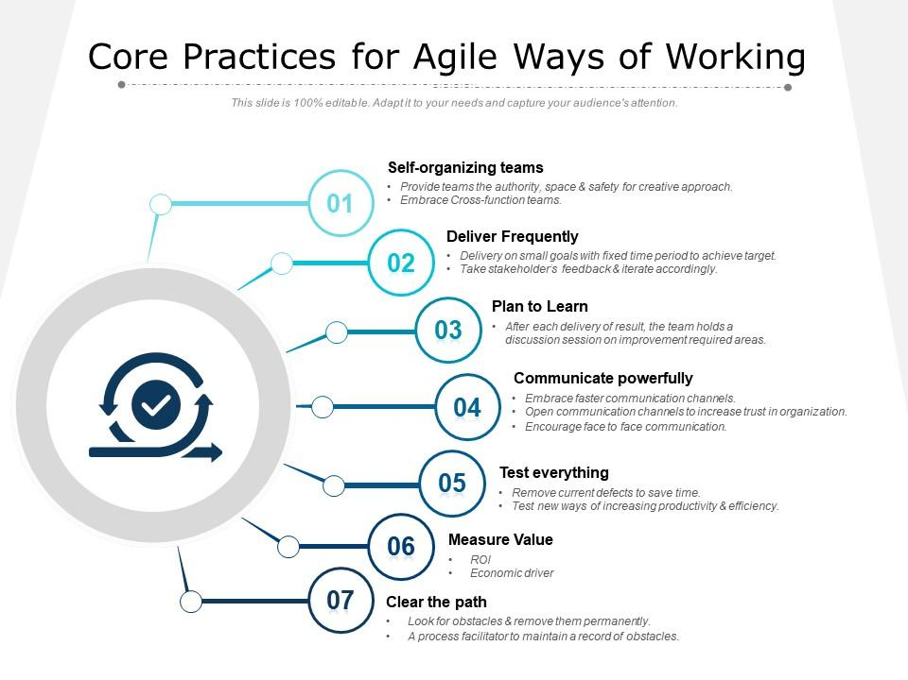
5 Agile development best practices

Slide 42
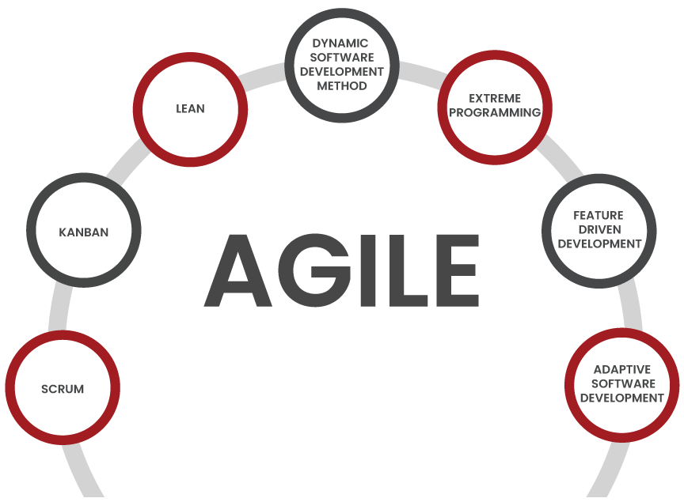
Key Agile Methodologies

Slide 43
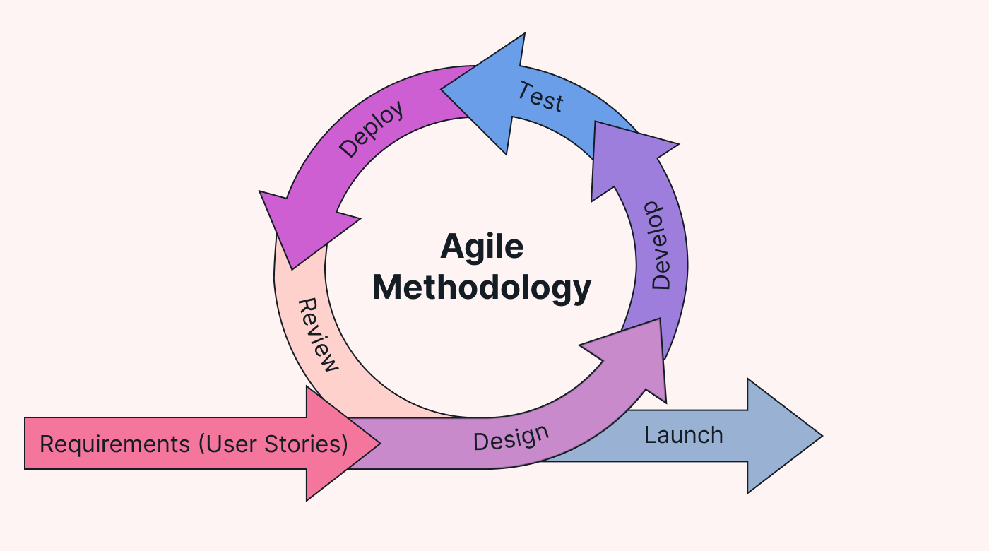
Phases (SDLC) of Agile Methodology

Slide 44
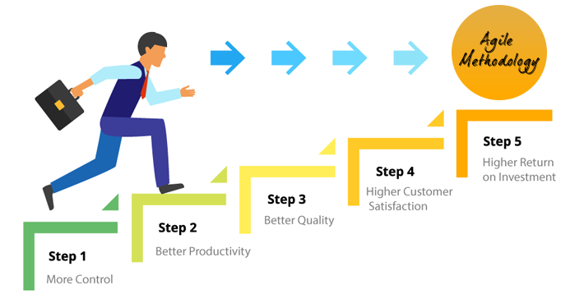
Agile Methodology supports

Slide 45
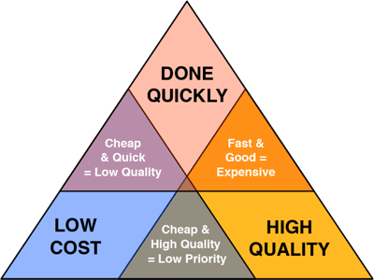
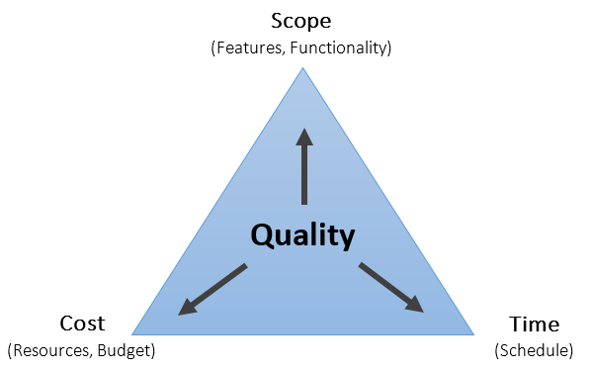
Agile Quality
Resources are adjusted to ensure successful project completion.

Slide 46
Object-Oriented (O-O) Systems Analysis and Design
Alternate approach to the structured approach of the SDLC that is intended to facilitate the development of systems that change rapidly in response to dynamic business environments
Analysis is performed on a small part of the system followed by design and implementation.
The cycle repeats with analysis, design, and implementation of the next part and this repeats until the project is complete.
Examines the objects of a system

Slide 47
Unified Modeling Language (UML) Phases
Define the use case model:
Use case diagram
Use case scenarios
Create UML diagrams.
Develop class diagrams.
Modify the UML diagrams.
Develop and document the system.

Slide 48
Choosing a Method
Choose either:
SDLC
Agile
Object-oriented methodologies

Slide 49
Object-Oriented Analysis and Design
Based on objects rather than data or processes
Object: a structure encapsulating attributes and behaviors of a real-world entity
Object class: a logical grouping of objects sharing the same attributes and behaviors
Inheritance: hierarchical arrangement of classes enable subclasses to inherit properties of superclasses

Slide 50
When to Use SDLC
Systems have been developed and documented using SLDC.
It is important to document each step.
Upper level management feels more comfortable or safe using SDLC.
There are adequate resources and time to complete the full SDLC.
Communication of how new systems work is important.

Slide 51
When to Use Agile
There is a project champion of agile methods in the organization.
Applications need to be developed quickly in response to a dynamic environment.
A rescue takes place (the system failed and there is no time to figure out what went wrong).
The customer is satisfied with incremental improvements.
Executives and analysts agree with the principles of agile methodologies.

Slide 52
When to Use Object-Oriented
The problems modeled lend themselves to classes.
An organization supports the UML learning.
Systems can be added gradually, one subsystem at a time.
Reuse of previously written software is a possibility.
It is acceptable to tackle the difficult problems first.

Slide 53
Different Types of Information Systems
Transaction Processing Systems (TPS)
Office Automation Systems (OAS)
Knowledge Work Systems (KWS)
Management Information Systems (MIS)
Decision Support Systems (DSS)
Expert Systems (ES)
Executive Support Systems (ESS)
Group Decision Support Systems (GDSS)
Computer-Supported Collaborative Work Systems (CSCWS)

Slide 54
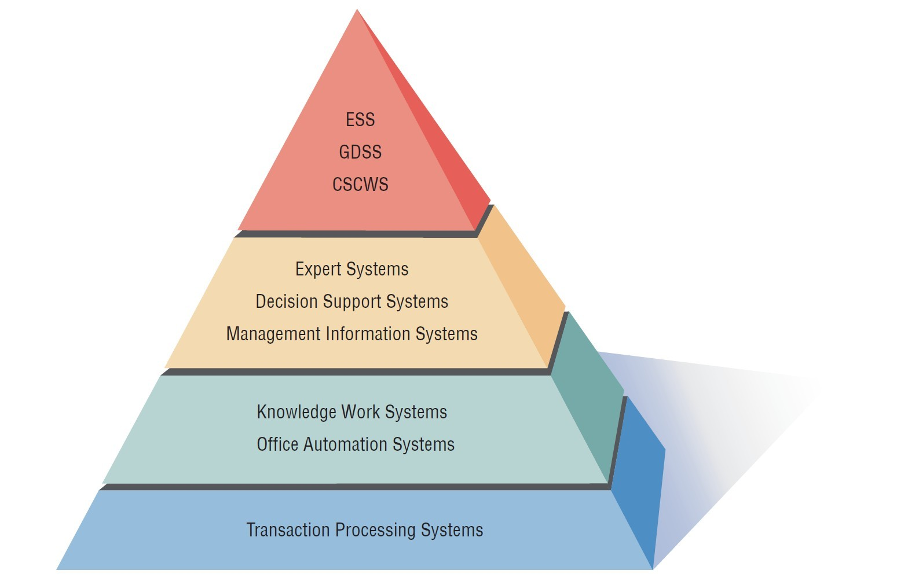
A systems analyst may be involved with any or all of these systems at each organization level.
Strategic Level
Higher Level
Knowledge Level
Operational Level

Slide 55
Operational Level
Transaction Processing System (TPS)
Process large amounts of data for routine business transactions
Support day-to-day operations of the company
Examples: Payroll Processing, Inventory Management

Slide 56
Knowledge Level
Office Automation System (OAS)
Supports data workers who share information, but do not usually create new knowledge
Examples: word processing, spreadsheets, desktop publishing, electronic scheduling, communication through voice mail, email, teleconferencing
Knowledge Work System (KWS)
Supports professional workers such as scientists, engineers, and doctors
Examples: computer-aided design systems, virtual reality systems, investment workstations

Slide 57
Higher Level
Management Information System (MIS)
Supports organizational tasks including decision analysis and decision making
Examples: profit margin by sales region, expenses vs. budgets
Decision Support System (DSS)
Supports decision makers in the making of decisions
Examples: financial planning with what-if analysis, budgeting with modeling
Expert System (ES) and Artificial Intelligence
Captures and uses the knowledge of an expert for solving a particular problem which leads to a conclusion or recommendation

Slide 58
Strategic Level
Executive Support System (ESS)
Helps executives to make unstructured strategic decisions in an informed way
Examples: drill-down analysis, status access
Group Decision Support System (GDSS)
Permit group members to interact with electronic support.
Examples: email, Lotus Notes
Computer-Supported Collaborative Work System (CSCWS)
CSCWS is a more general term of GDSS.
May include software support called groupware for team collaboration via network computers
Example: video conferencing, Web survey system

Slide 59
Integrating New Technologies into Traditional Systems
Ecommerce systems
Web based SW development Systems
Wireless communication systems
Mobile application SW/Systems
Enterprise resource planning systems (Oracle, Performs integration of many information systems existing on different management levels and within different functions)
Open Source Software need for Systems Analysis and Design

Slide 60
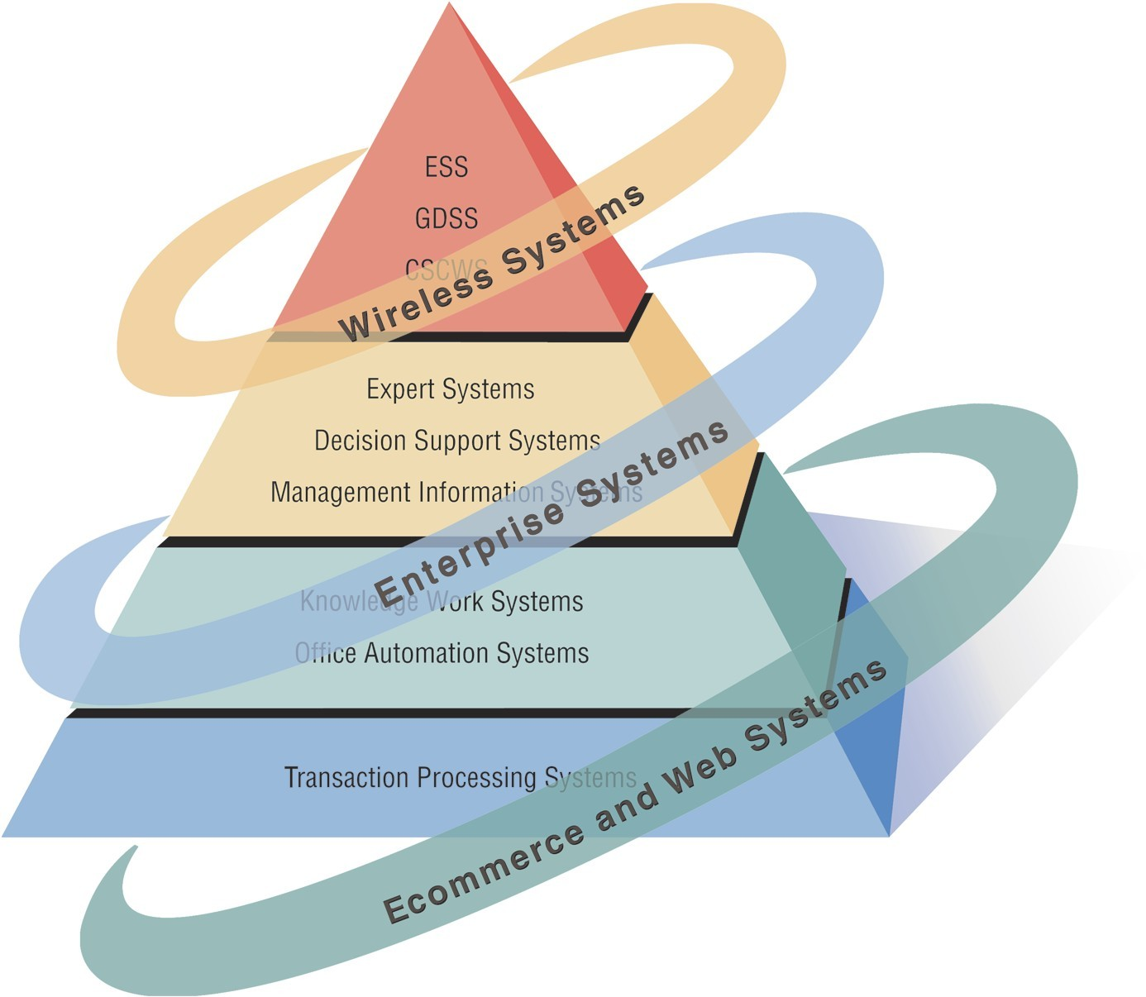
Systems Analysts Need to Be Aware that Integrating Technologies Affects all Types of Systems (Figure 1.2)

Slide 61
Summary
Information is a key resource.
Systems analysts deal with many types of information systems.
Integration of traditional systems with new technologies
Roles and qualities of the systems analyst
The systems development life cycle
CASE tools
Agile systems development
Object-oriented systems development

